Slide 1
Lifetime Sim Results (Wide)
Piper Zimmerman

Slide 2
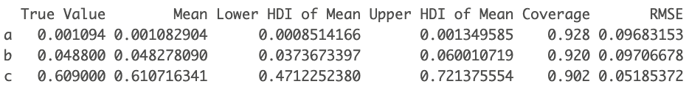
Lambda Exp

Slide 3
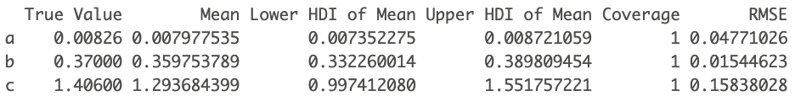
Lambda WB

Slide 4
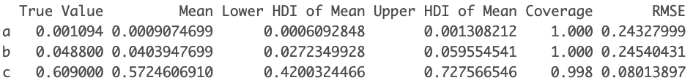
Mean Lambda Exp

Slide 5
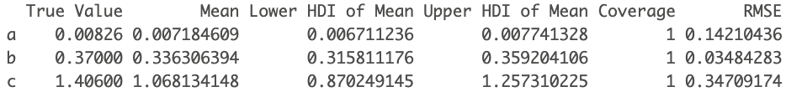
Mean Lambda WB

Slide 6
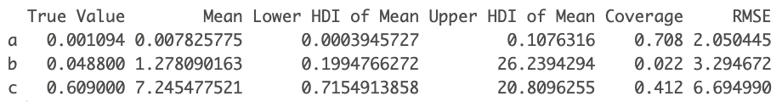
Inverse Lambda Exp

Slide 7
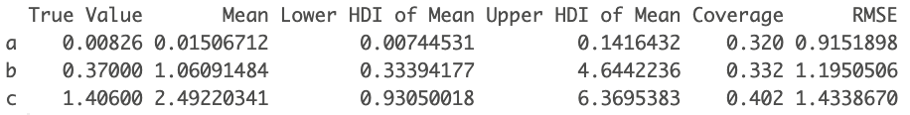
Inverse Lambda WB

Slide 8
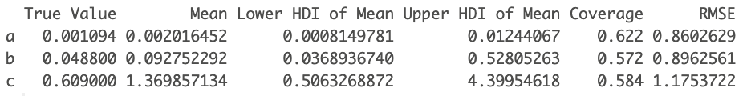
Mean Inverse Lambda Exp

Slide 9
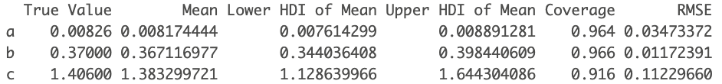
Mean Inverse Lambda WB

Slide 10
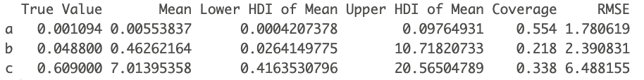
Inverse Mean Lambda Exp

Slide 11
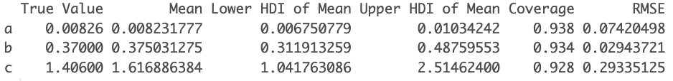
Inverse Mean Lambda WB

Slide 12
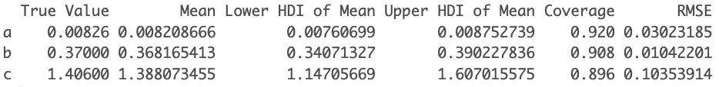
Weibull WB

Slide 13
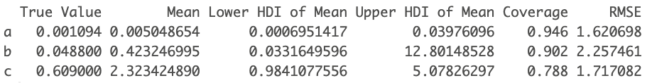
Inverse Lambda Exp (Not Truncated)

Slide 14
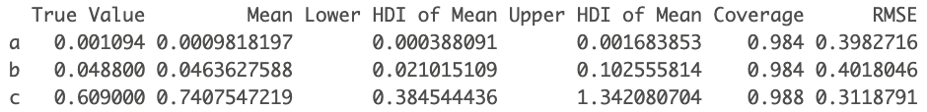
Mean Inverse Lambda Exp (Not Truncated)

Slide 15
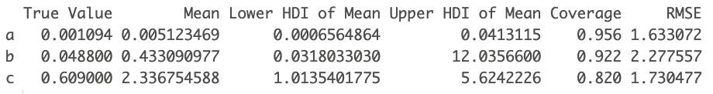
Inverse Mean Lambda Exp (Not Truncated)

Slide 16
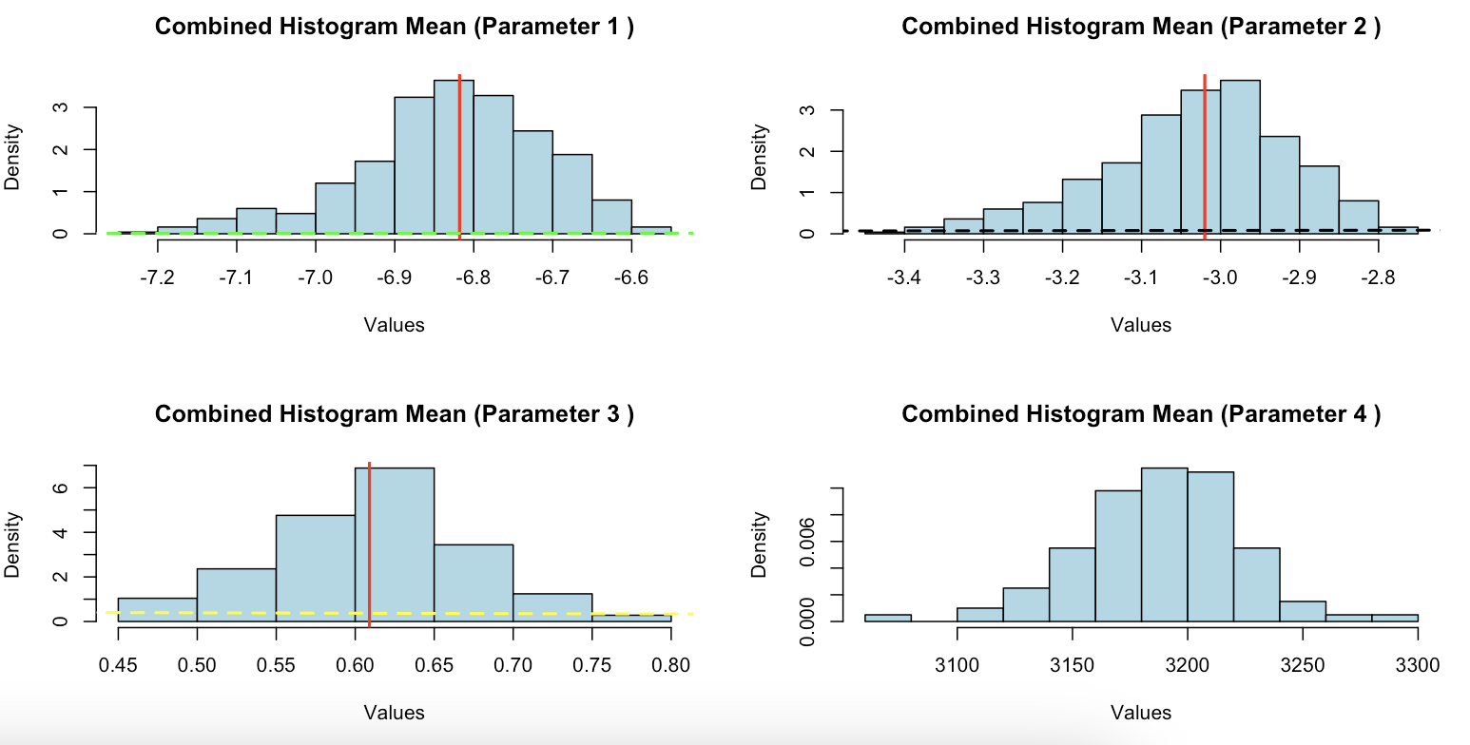
Lambda Exp

Slide 17
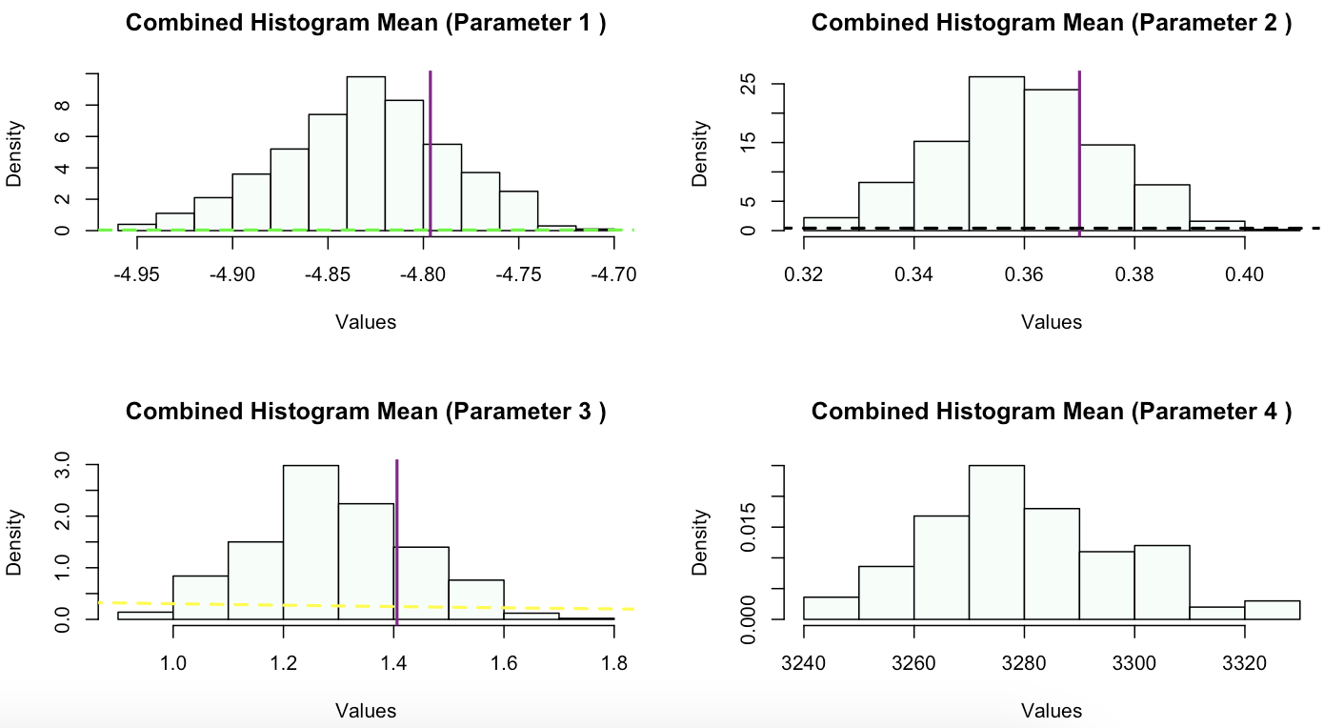
Lambda Exp

Slide 18
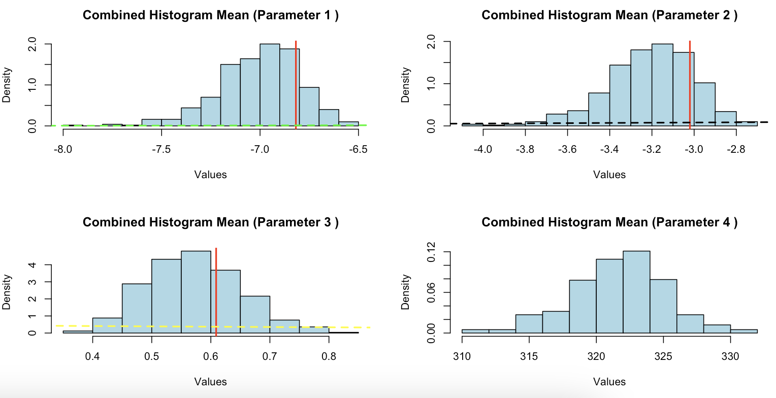
Mean Lambda Exp

Slide 19
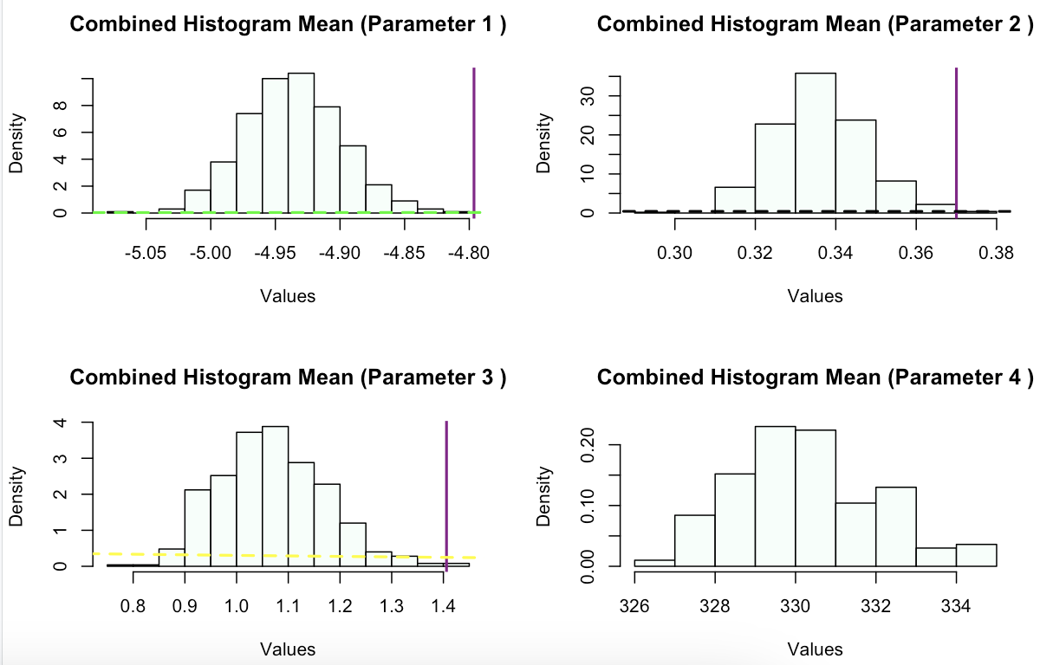
Mean Lambda WB

Slide 20
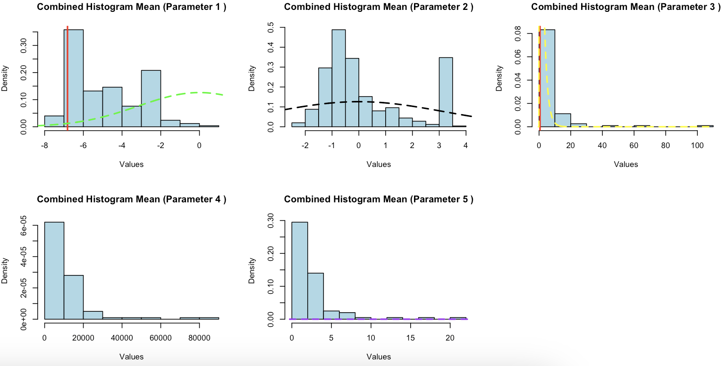
Inverse Lambda Exp

Slide 21
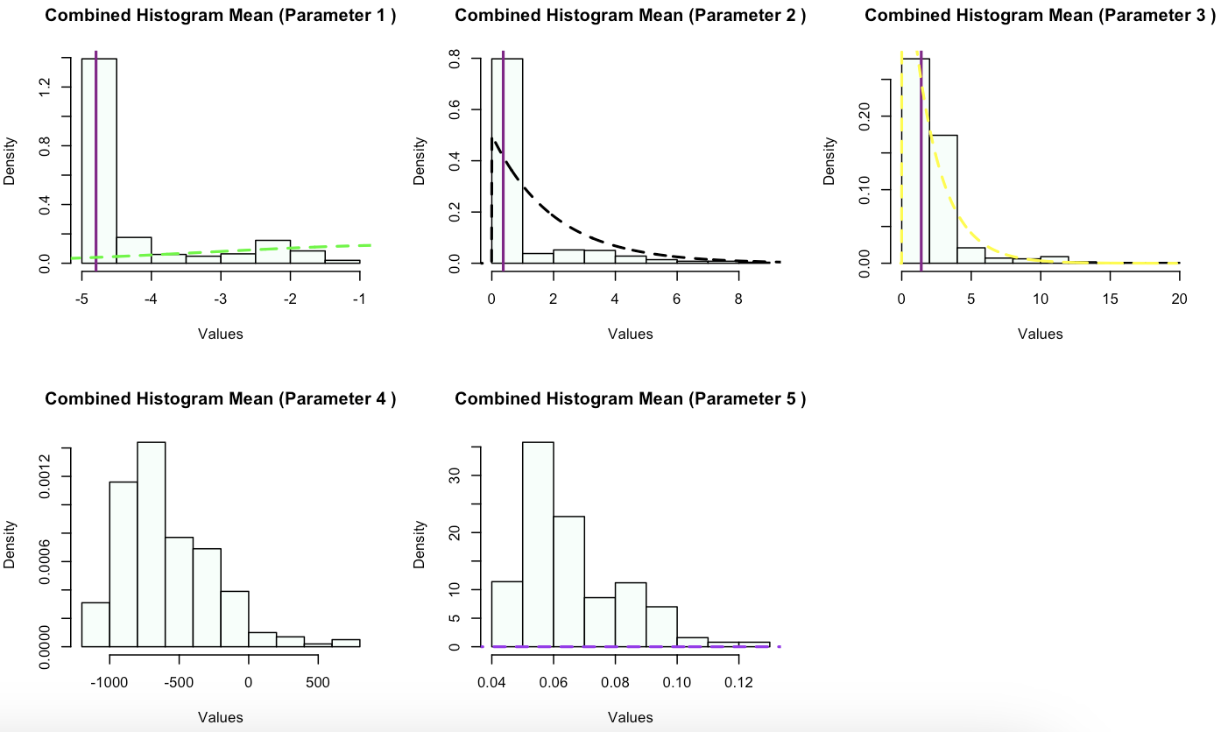
Inverse Lambda WB

Slide 22
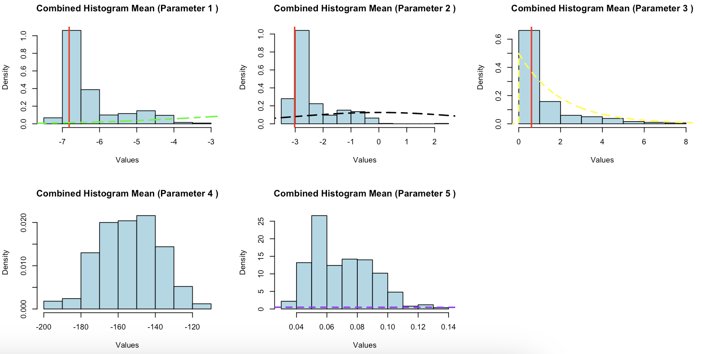
Mean Inverse Lambda Exp

Slide 23
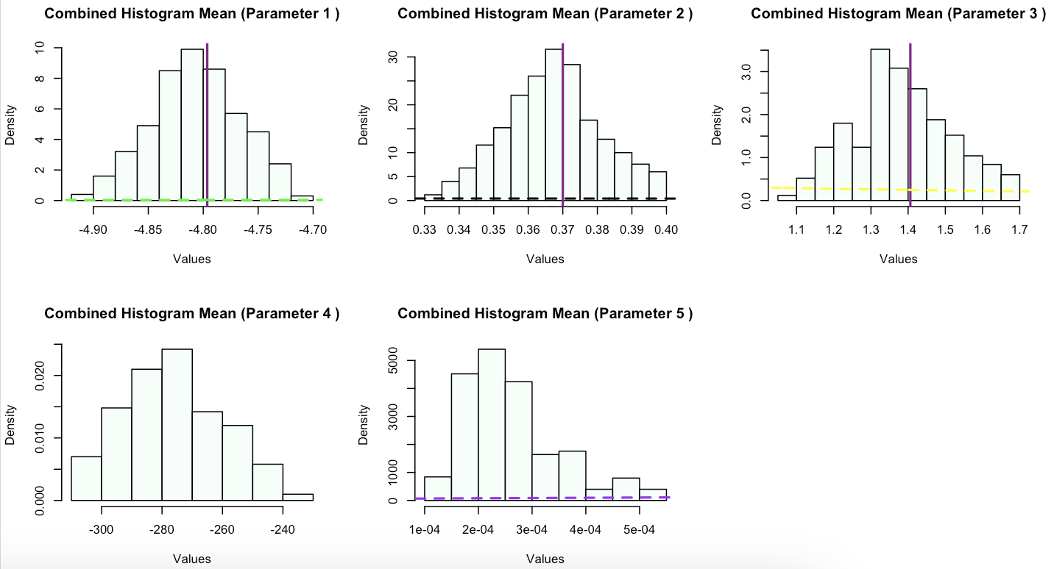
Mean Inverse Lambda WB

Slide 24
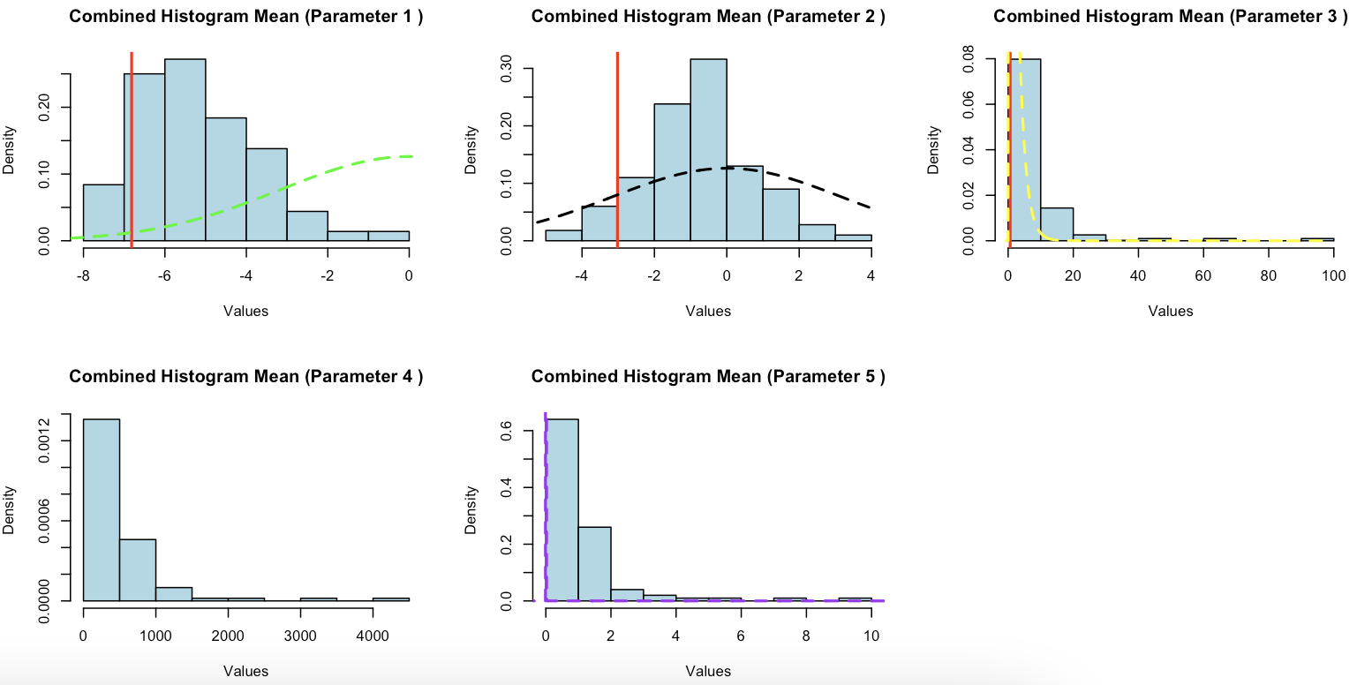
Inverse Mean Lambda Exp

Slide 25
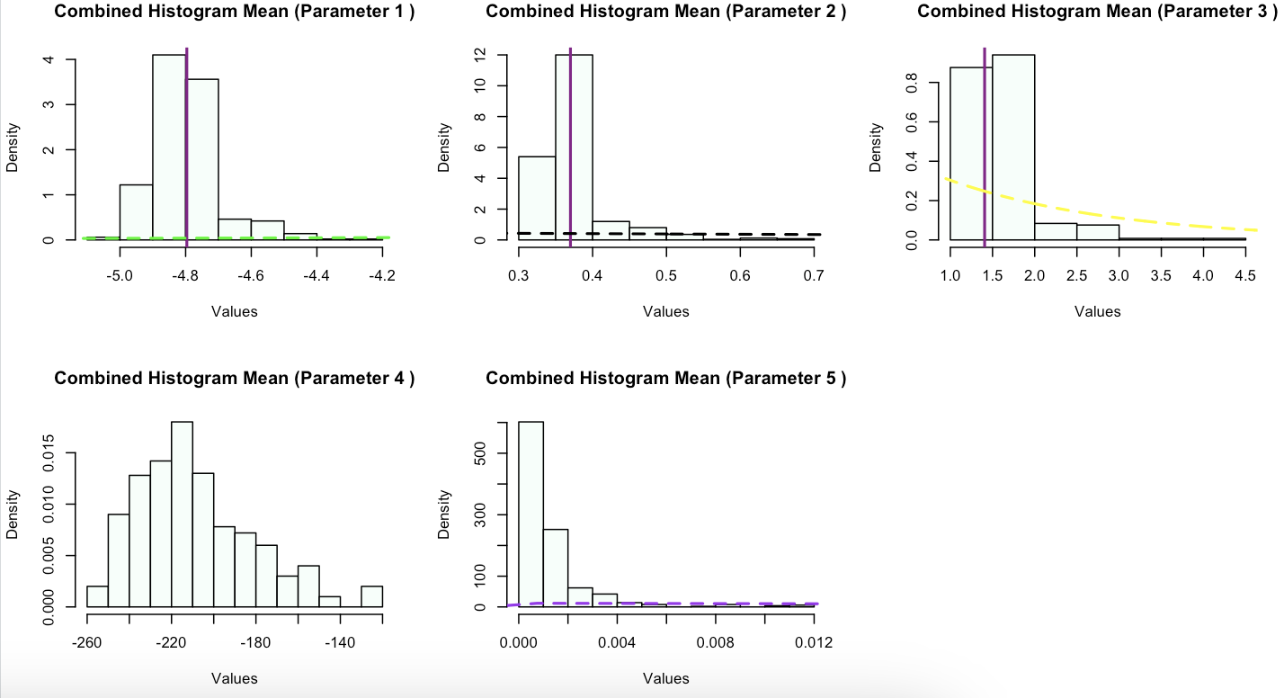
Inverse Mean Lambda WB

Slide 26
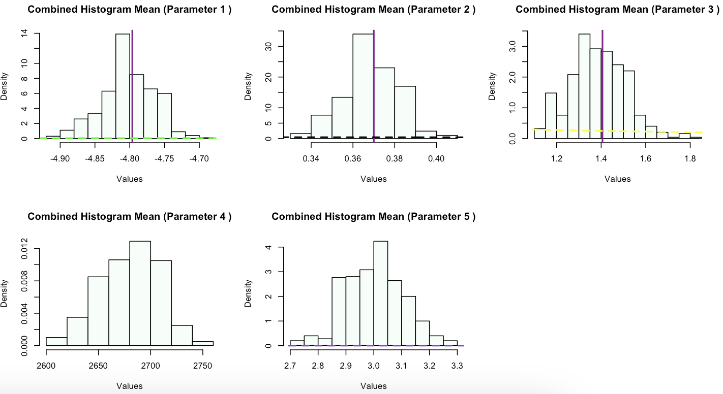
Weibull WB

Slide 27
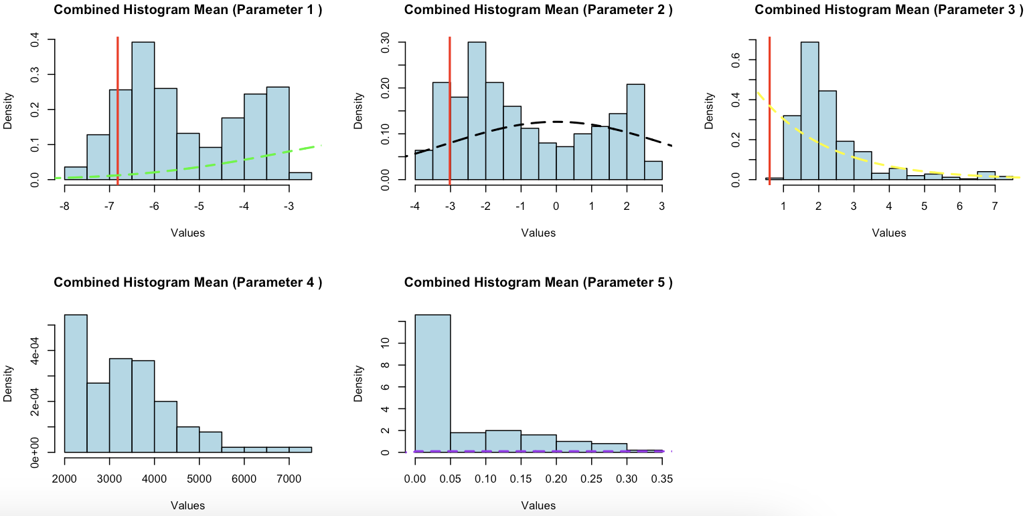
Inverse Lambda Exp (Not Truncated)

Slide 28
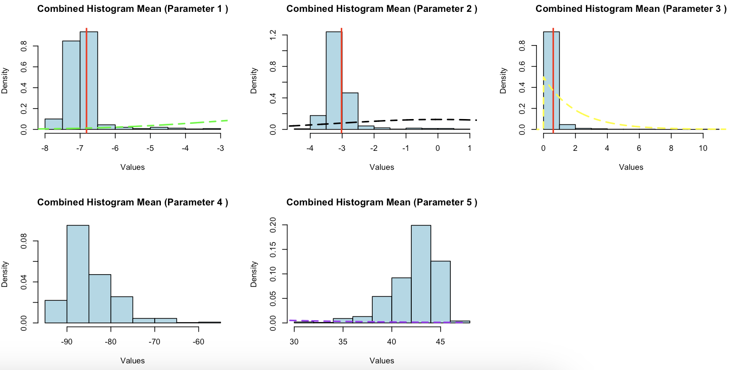
Mean Inverse Lambda Exp (Not Truncated)

Slide 29
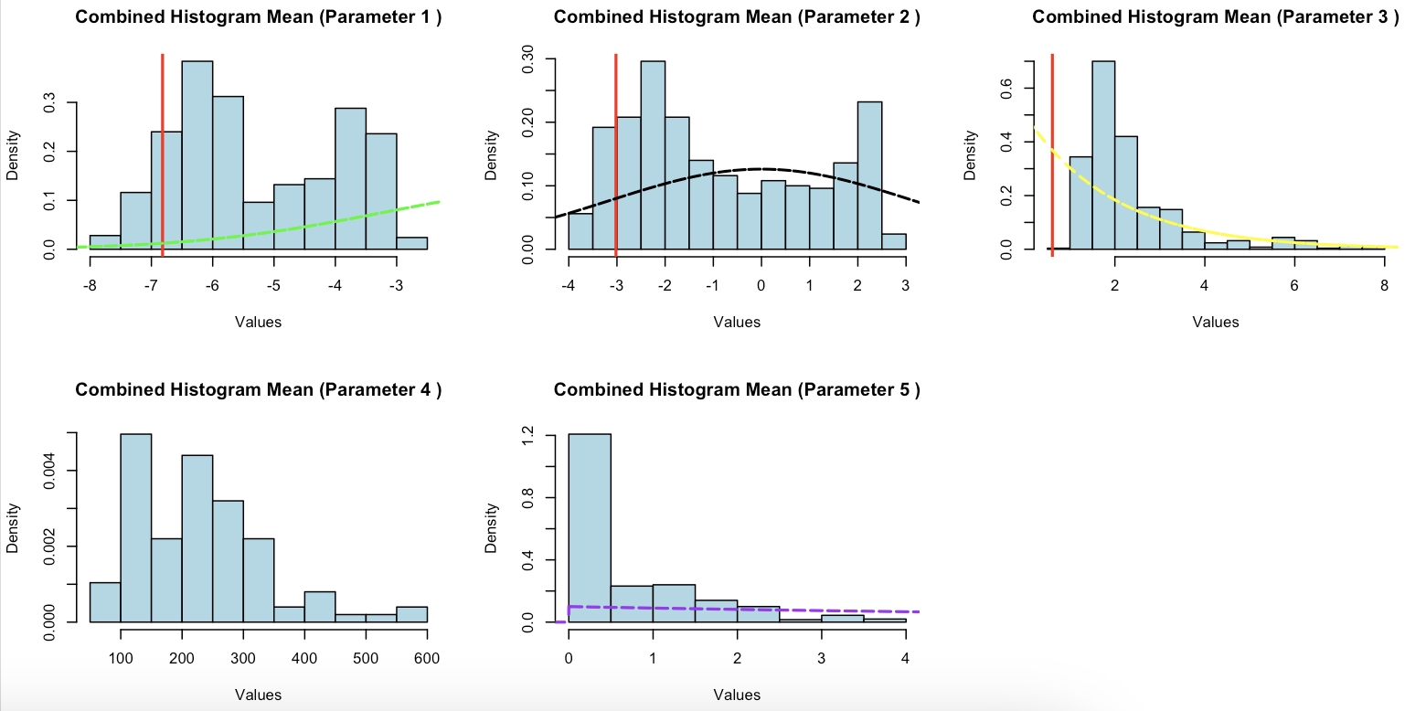
Inverse Mean Lambda Exp (Not Truncated)

Slide 30
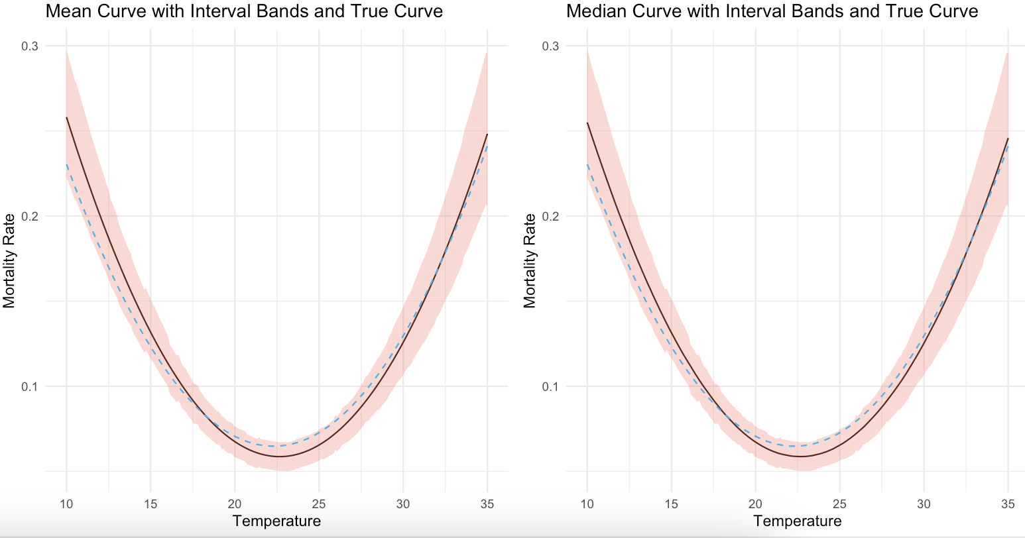
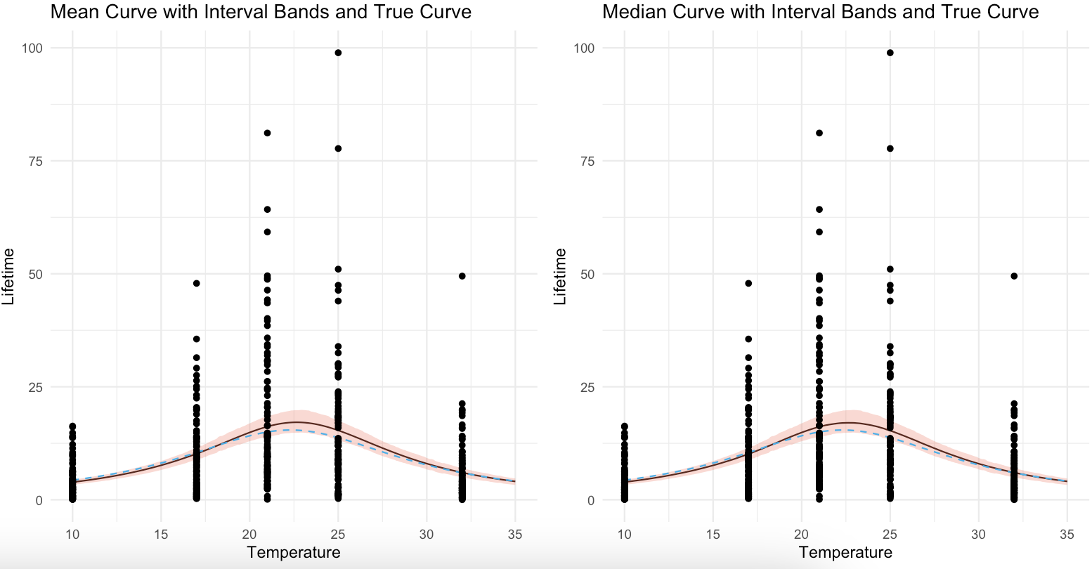
Lambda Exp

Slide 31
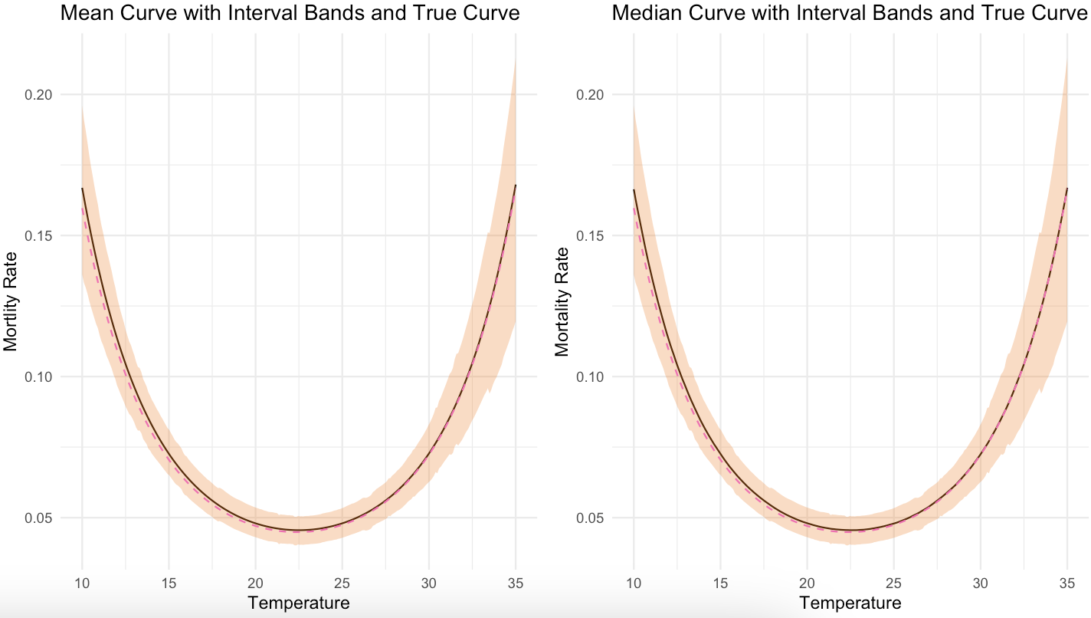
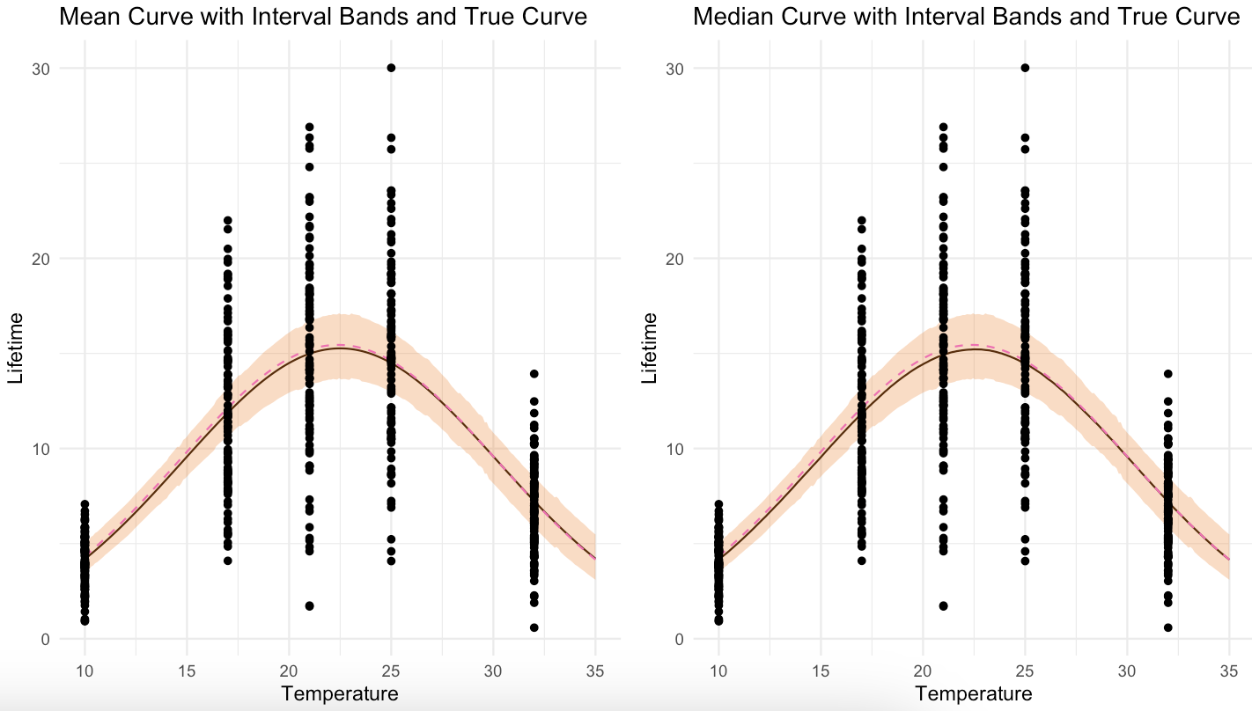
Lambda WB

Slide 32
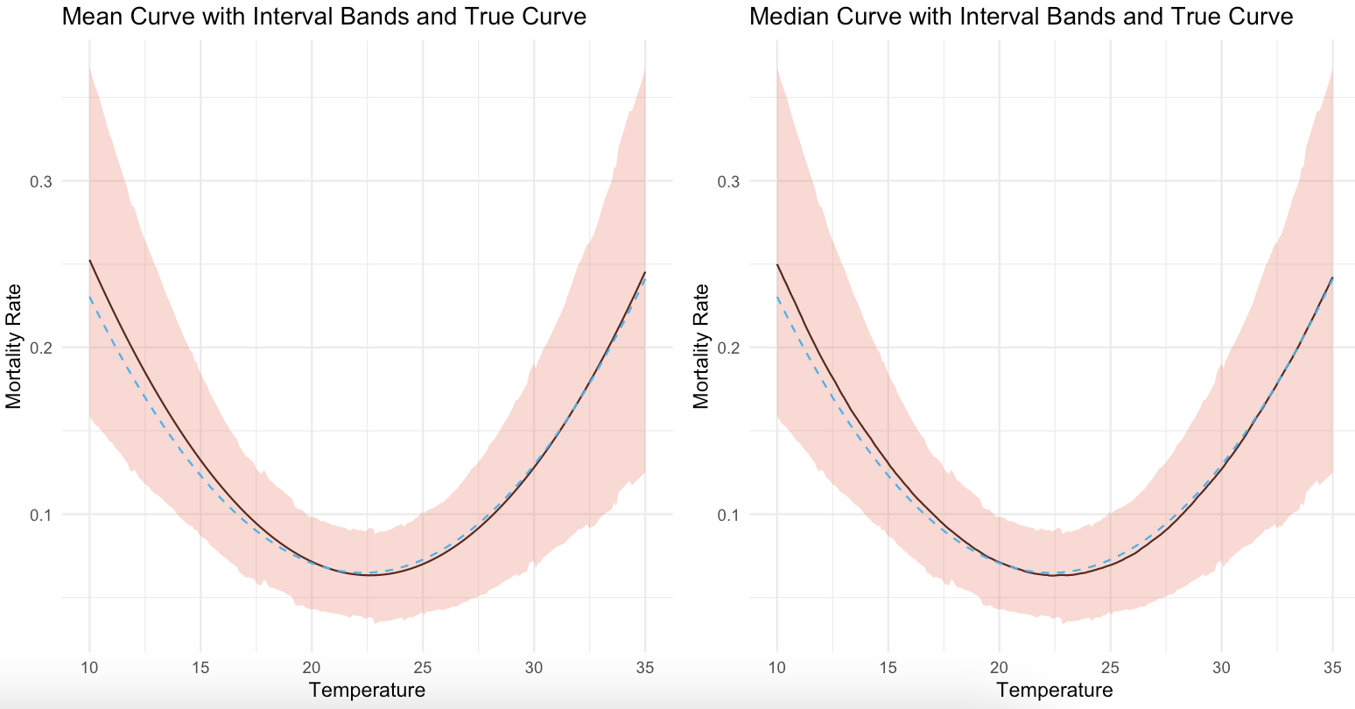
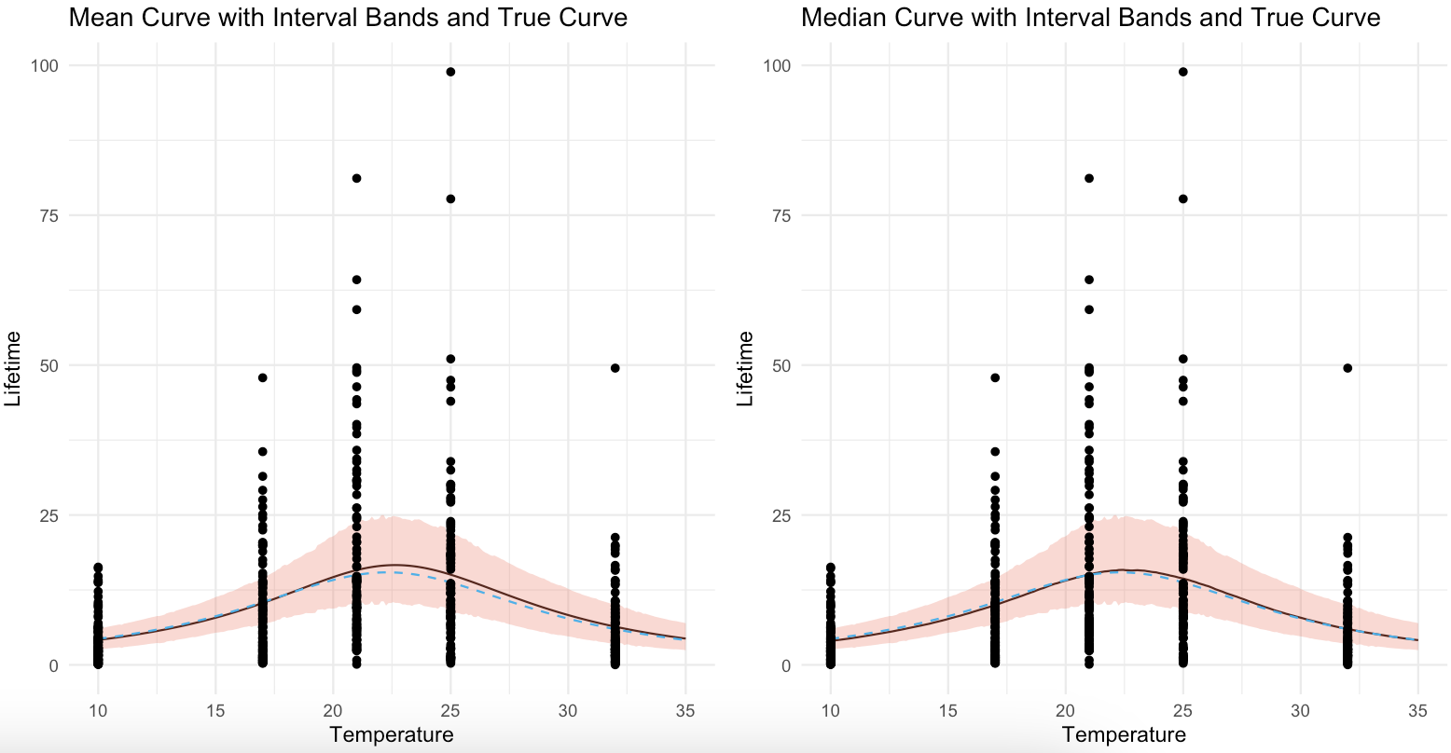
Mean Lambda Exp

Slide 33
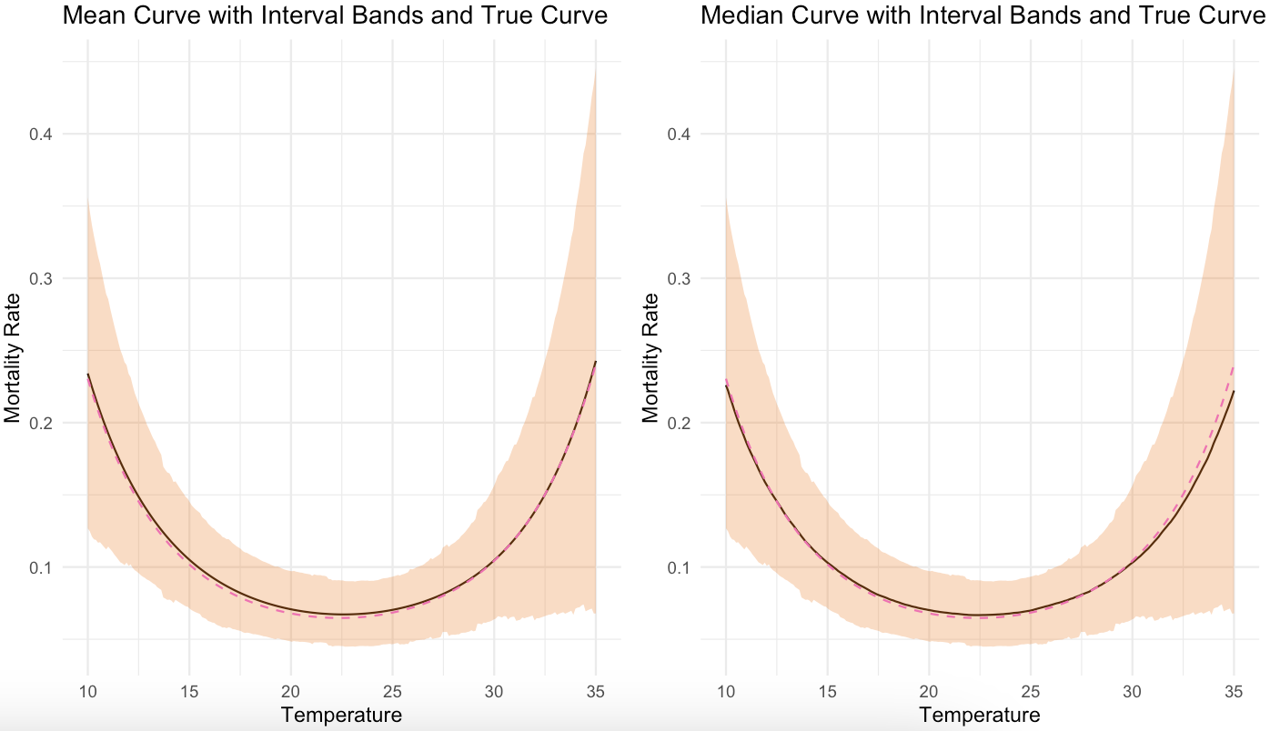
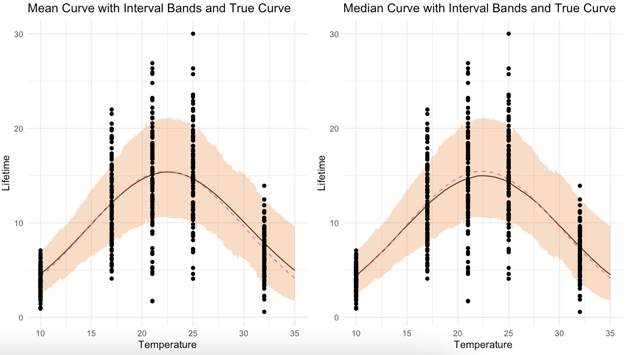
Mean Lambda WB

Slide 34
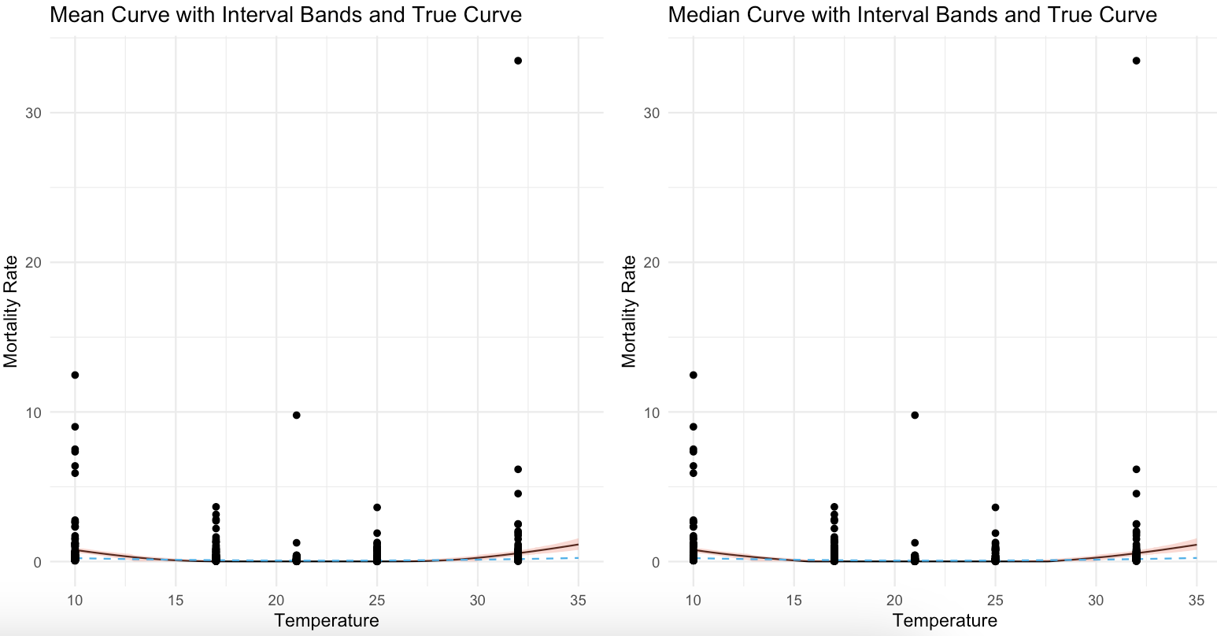
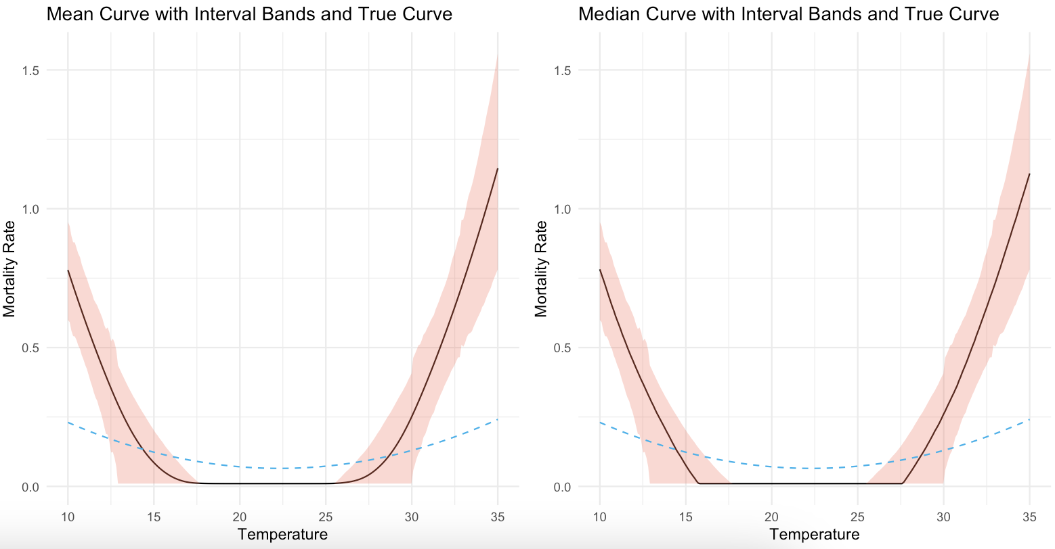
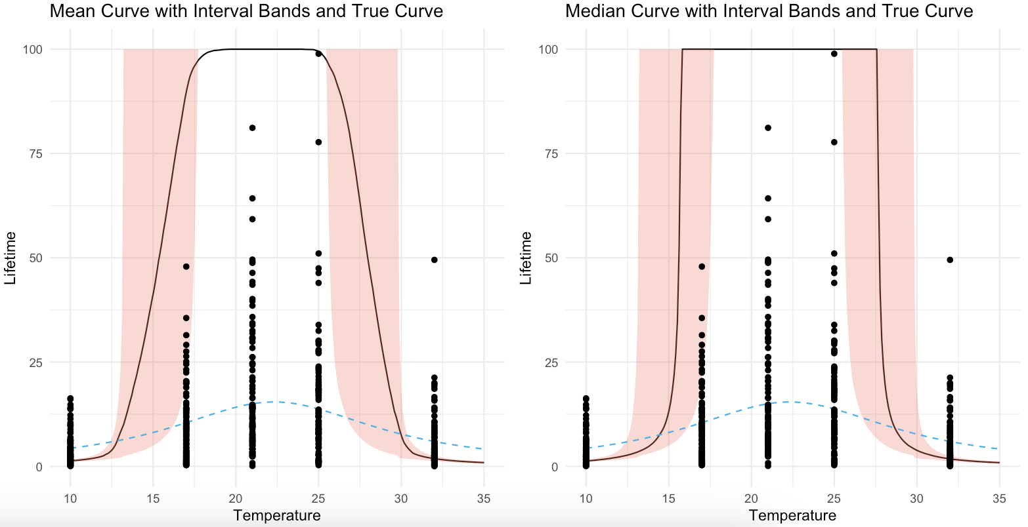
Inverse Lambda Exp

Slide 35
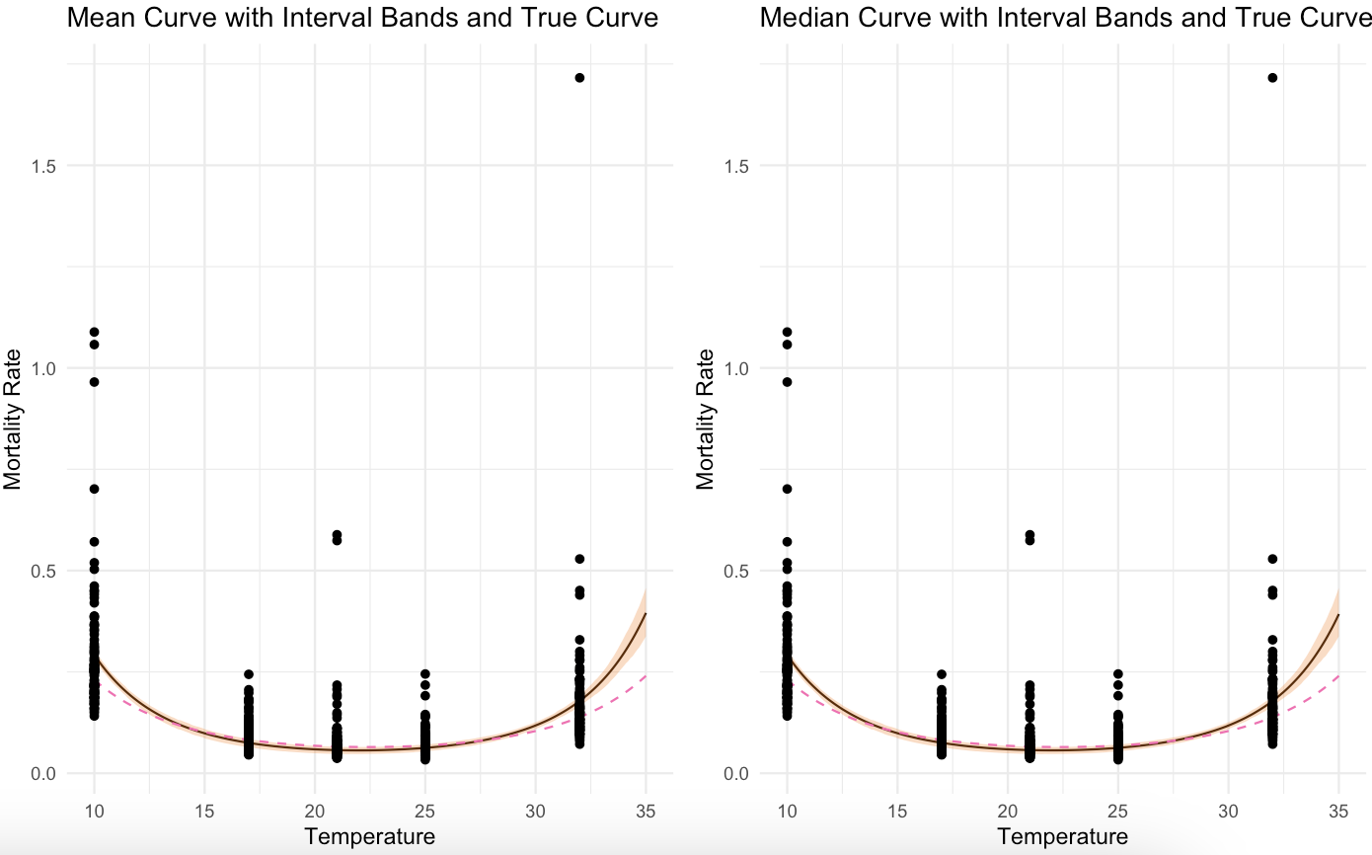
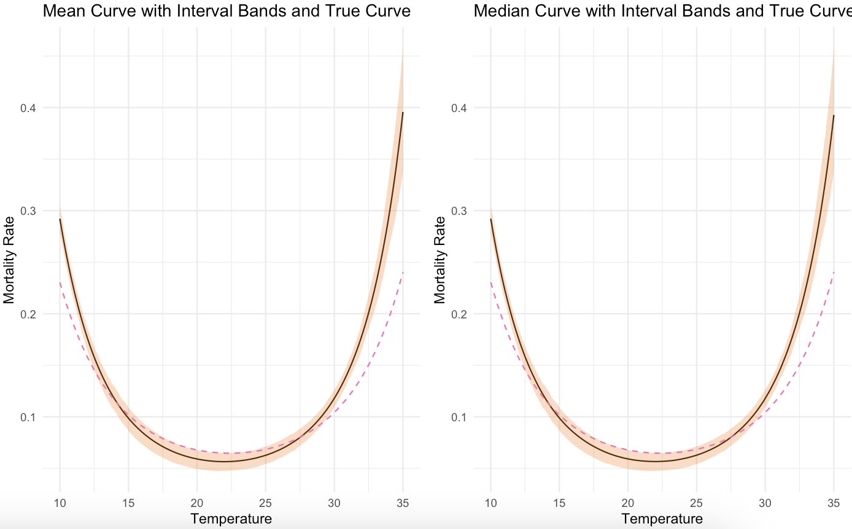
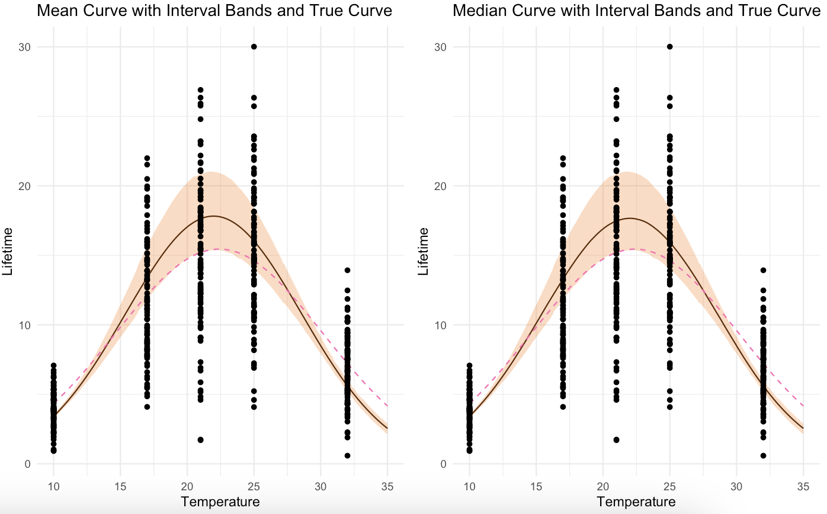
Inverse Lambda WB

Slide 36
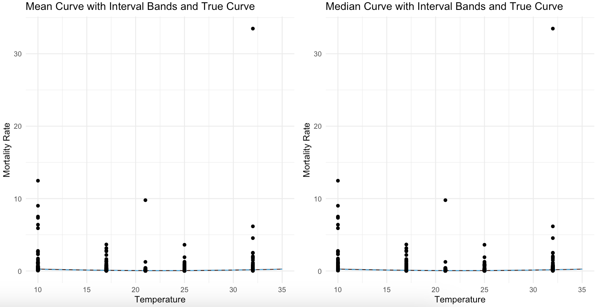
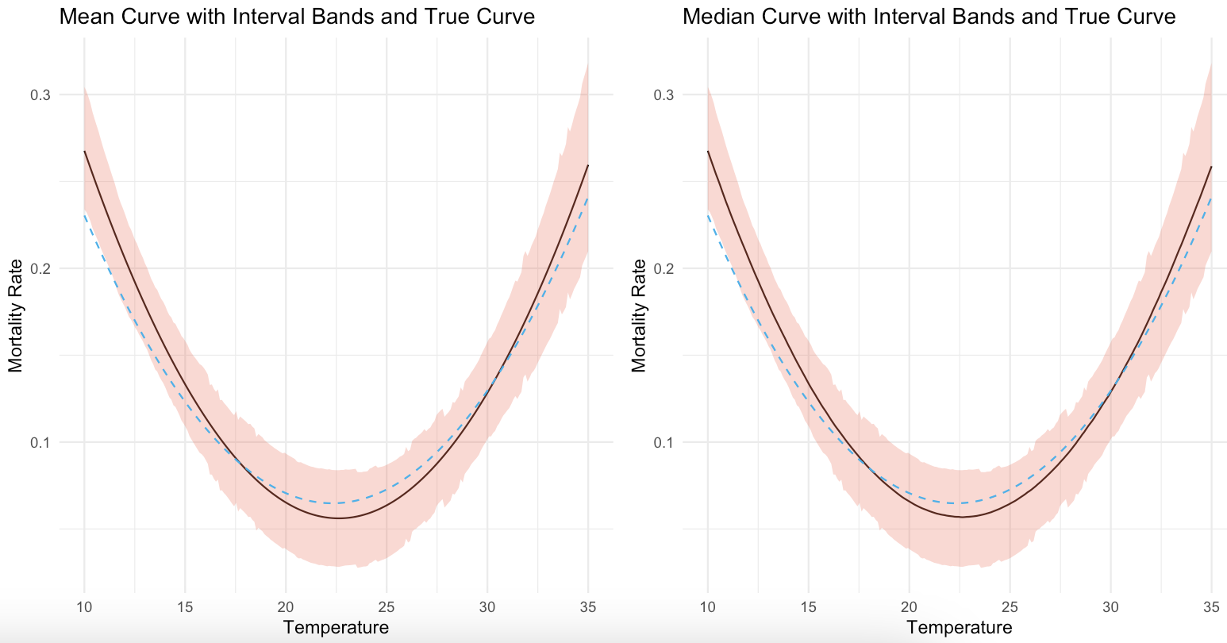
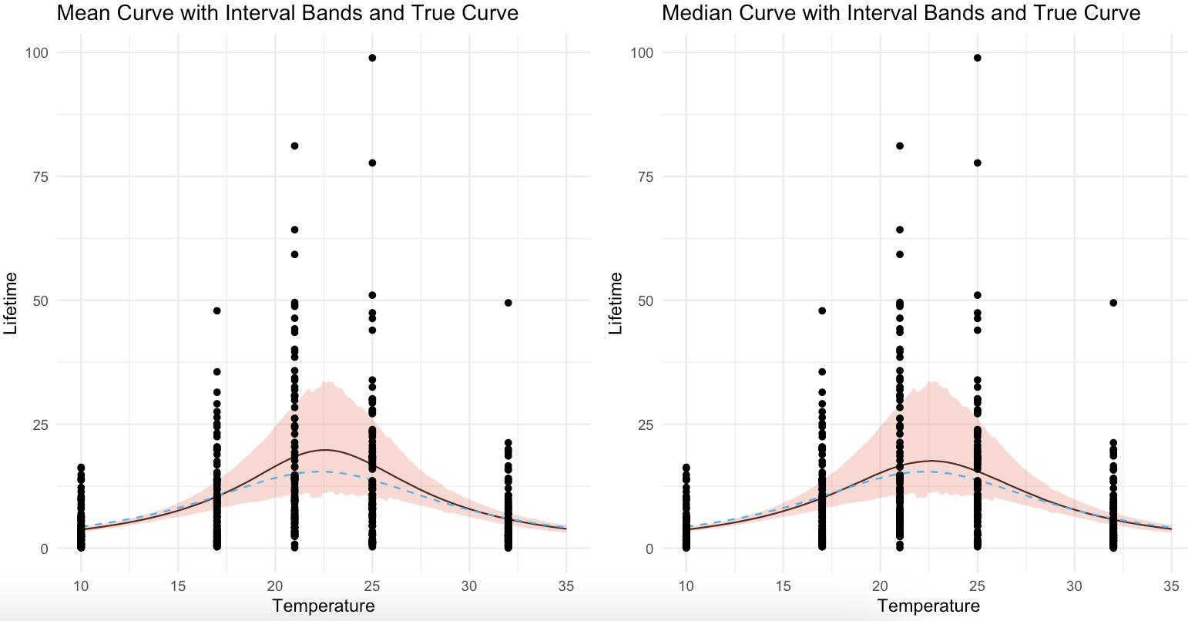
Mean Inverse Lambda Exp

Slide 37
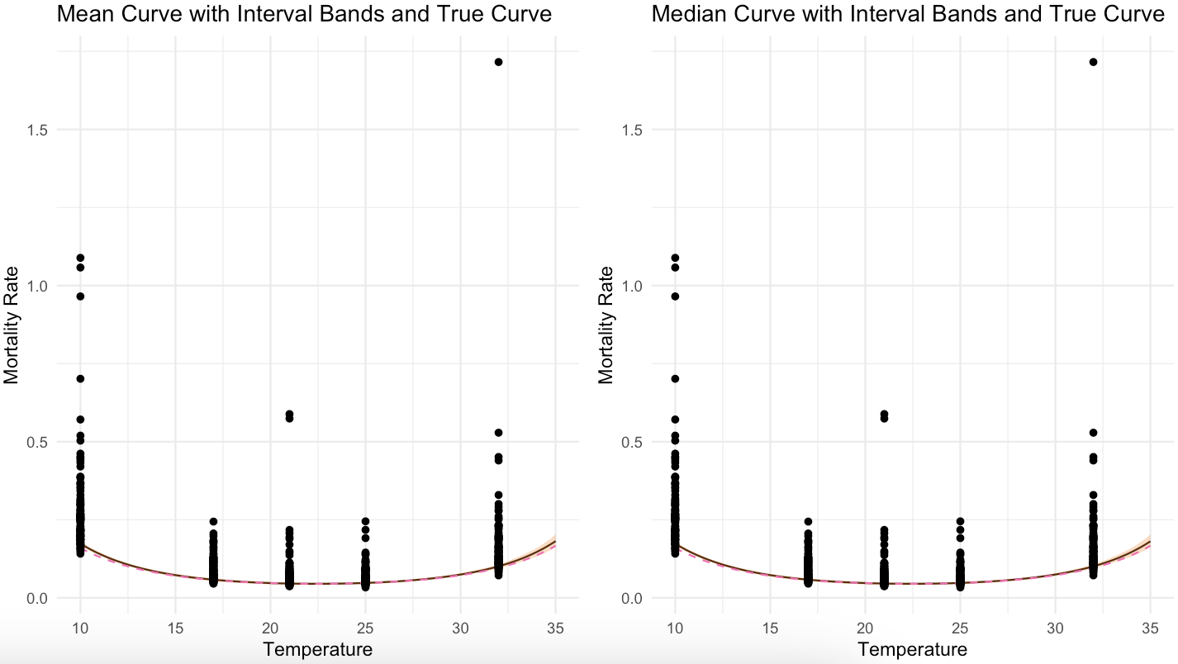
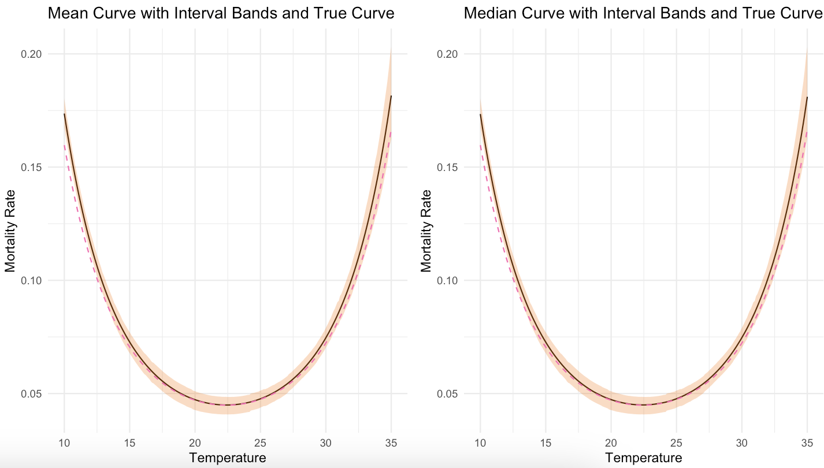

Mean Inverse Lambda WB

Slide 38
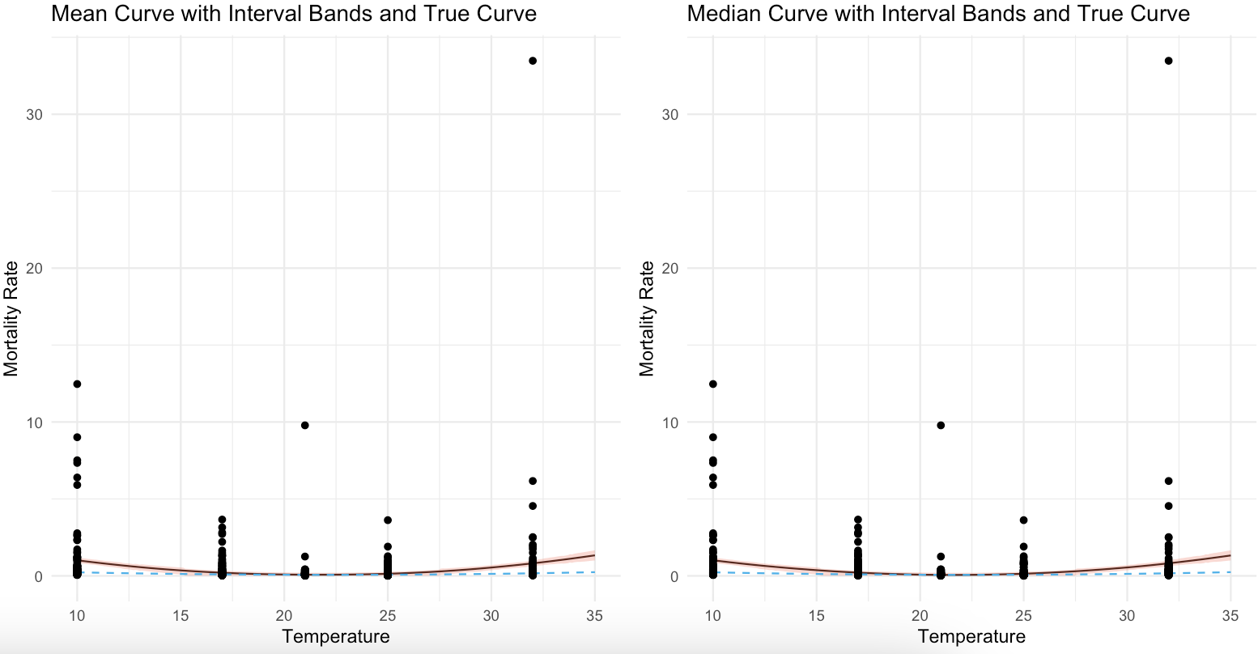
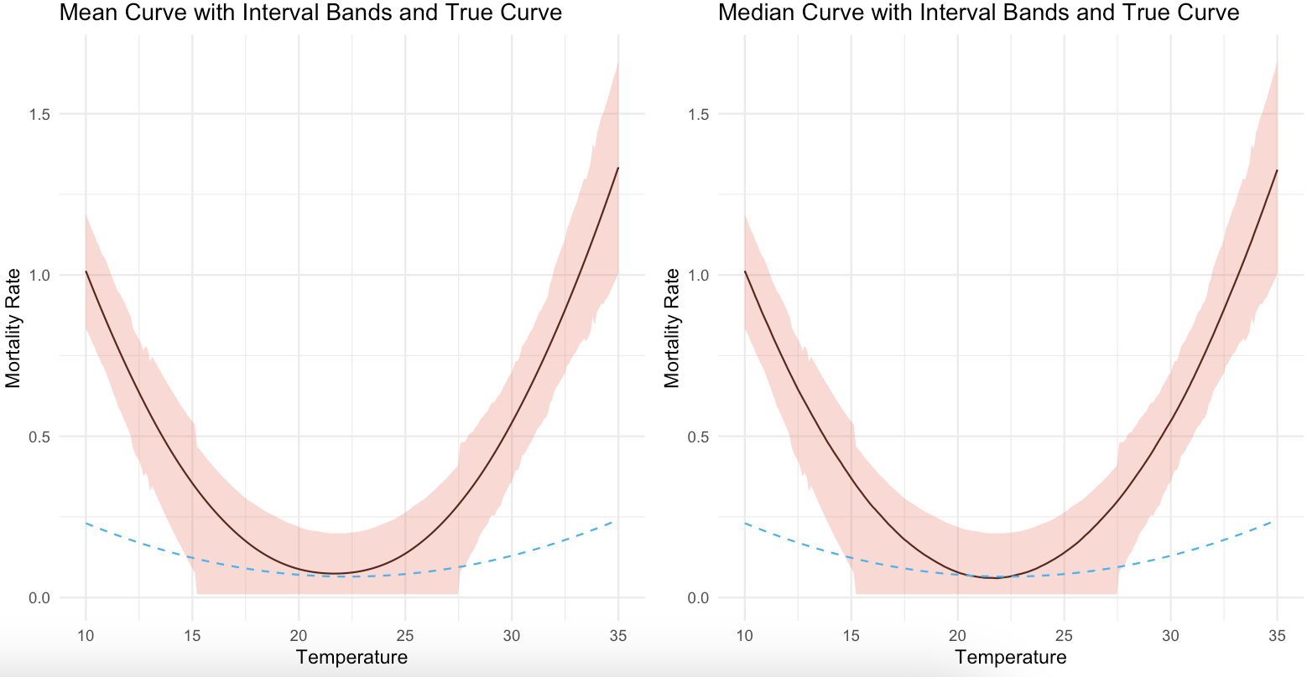
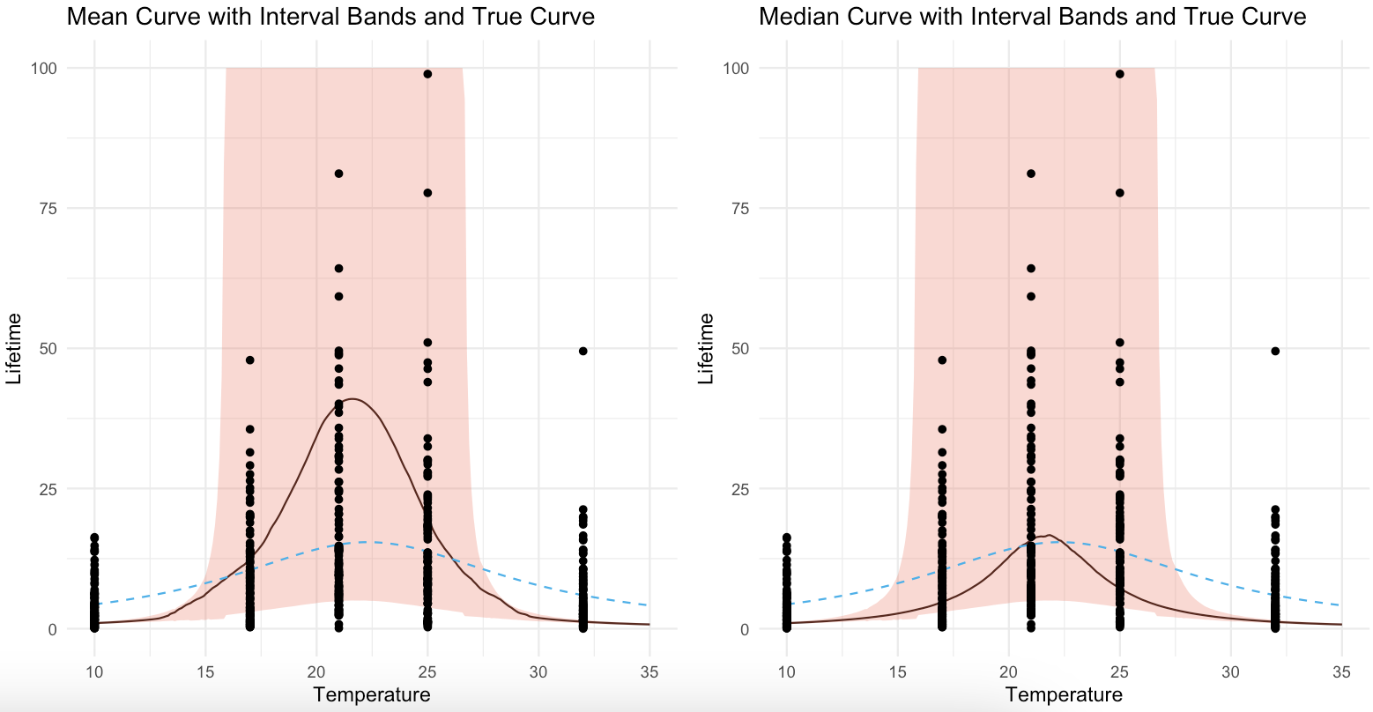
Inverse Mean Lambda Exp

Slide 39



Inverse Mean Lambda WB

Slide 40


Weibull WB

Slide 41



Inverse Lambda Exp (Not Truncated)

Slide 42



Mean Inverse Lambda Exp (Not Truncated)

Slide 43



Inverse Mean Lambda Exp (Not Truncated)

Slide 44

Lambda Exp

Slide 45

Mean Lambda Exp

Slide 46

Inverse Lambda Exp

Slide 47

Mean Inverse Lambda Exp

Slide 48

Inverse Mean Lambda Exp

Slide 49

Inverse Lambda Exp (Not Truncated)

Slide 50

Mean Inverse Lambda Exp (Not Truncated)

Slide 51

Inverse Mean Lambda Exp (Not Truncated)

Slide 52



Comparisons Exp

Slide 53



Comparisons WB

Slide 54



Comparisons Exp (Log)

Slide 55



Comparisons WB (Log)

Slide 56



Comparisons Exp (Not Truncated)

Slide 57



Comparisons Exp (Not Truncated/Log)

Slide 58

WB/Exp Data Comparison- A

Slide 59

WB/Exp Data Comparison- A

Slide 60

WB/Exp Data Comparison- B

Slide 61

WB/Exp Data Comparison- B

Slide 62

WB/Exp Data Comparison- C

Slide 63

WB/Exp Data Comparison- C

Slide 64


Topt vs Lifetime- Mean

Slide 65


Topt vs Lifetime- Median

Slide 66


1 Day Lifetime Low vs High Temperature- Mean

Slide 67


1 Day Lifetime Low vs High Temperature- Median

Slide 68





QQPlot Exponential Data

Slide 69






QQPlot Weibull Data

Slide 70


RMSE Exponential Data

Slide 71


RMSE Weibull Data

Slide 72


RMSE Comparison

Slide 73
Lifetime Sim Results (Narrow)
Piper Zimmerman

Slide 74

Lambda Exp

Slide 75

Mean Lambda Exp

Slide 76

Inverse Lambda Exp

Slide 77

Mean Inverse Lambda Exp

Slide 78

Inverse Mean Lambda Exp

Slide 79

Inverse Lambda Exp (Not Truncated)

Slide 80

Mean Inverse Lambda Exp (Not Truncated)

Slide 81

Inverse Mean Lambda Exp (Not Truncated)

Slide 82

Mean Lambda Exp

Slide 83

Lambda Exp

Slide 84

Inverse Lambda Exp

Slide 85

Mean Inverse Lambda Exp

Slide 86

Inverse Mean Lambda Exp

Slide 87

Inverse Lambda Exp (Not Truncated)

Slide 88

Mean Inverse Lambda Exp (Not Truncated)

Slide 89

Inverse Mean Lambda Exp (Not Truncated)

Slide 90


Lambda Exp

Slide 91


Mean Lambda Exp

Slide 92


Inverse Lambda Exp

Slide 93


Mean Inverse Lambda Exp

Slide 94


Inverse Mean Lambda Exp

Slide 95


Inverse Lambda Exp (Not Truncated)

Slide 96


Mean Inverse Lambda Exp (Not Truncated)

Slide 97


Inverse Mean Lambda Exp (Not Truncated)

Slide 98



Comparisons Exp

Slide 99



Comparisons Exp (Log)

Slide 100



Comparisons Exp (Not Truncated)

Slide 101



Comparisons Exp (Not Truncated/Log)

